Slide 1


Team C Min Chen, Jia Lin
A Visual Analysis on the Impact of Covid-19 on Hardest Hit Areas Using Machine Learning Algorithm
Student No.: Min Chen: x19205040, Jia Lin: x22117644

Slide 2
Introdcution
The Covid-19 pandemic has caused enormous society and community crisis word widely. The impact of the Covid-19 has been studied.
While the pandemic has been hitting harder on certain areas and communities. Obviously, those unequal impact implies that there are some other key factors behind which have impacted the community status differ from each other.
This project is focusing on visualising the factors, which impact status of hardest hit areas apart from Covid-19 pandemic, using decision tree machine learning algorithm. As no previous studies could be found to identify this area.
The best way to exhibit Covid-19 data changes is statistical visualisation which can be used to help people discover and identify the hardest hit areas in time.

Slide 3

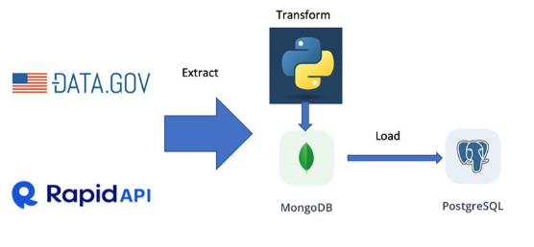
Datasets and Methodology
Dataset 1 : Covid-19 Vulnerable Community Crosswalks
Dataset 2: Covid-19 Statistics
The CRISP-DM methodology
ETL (Extract, Transform, Load) Pipeline

Slide 4

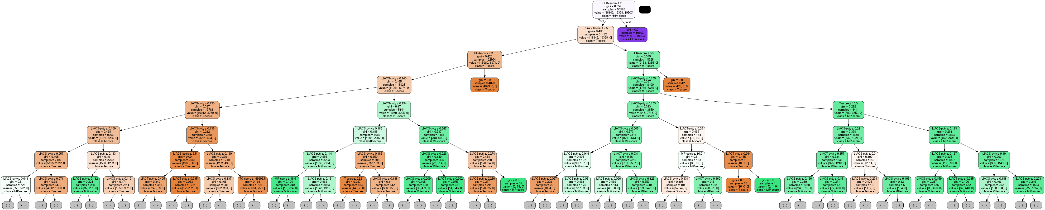
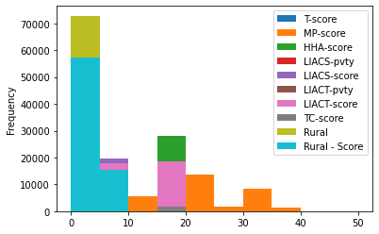
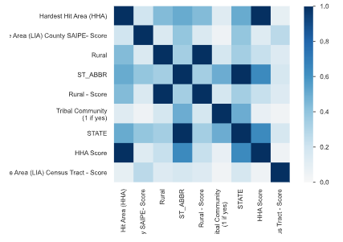
Data processing and Modelling
Apart from the pandemic, is status of HHA also determined by rural area, or tribal community, low income, and poverty, as well as poverty percentage?
Decision Tree ML algorithm has been chosen to identify the question.

Slide 5
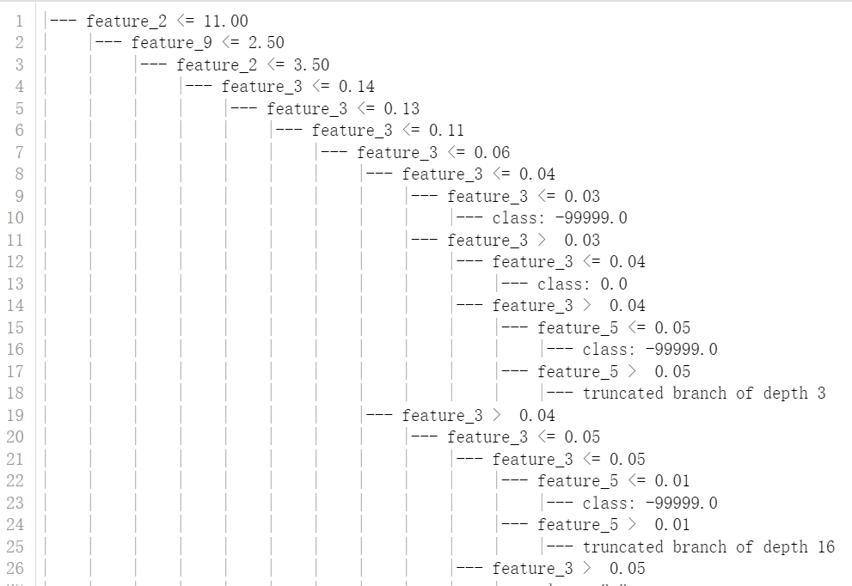
Decision Tree Model 87.65% Accuracy

Slide 6
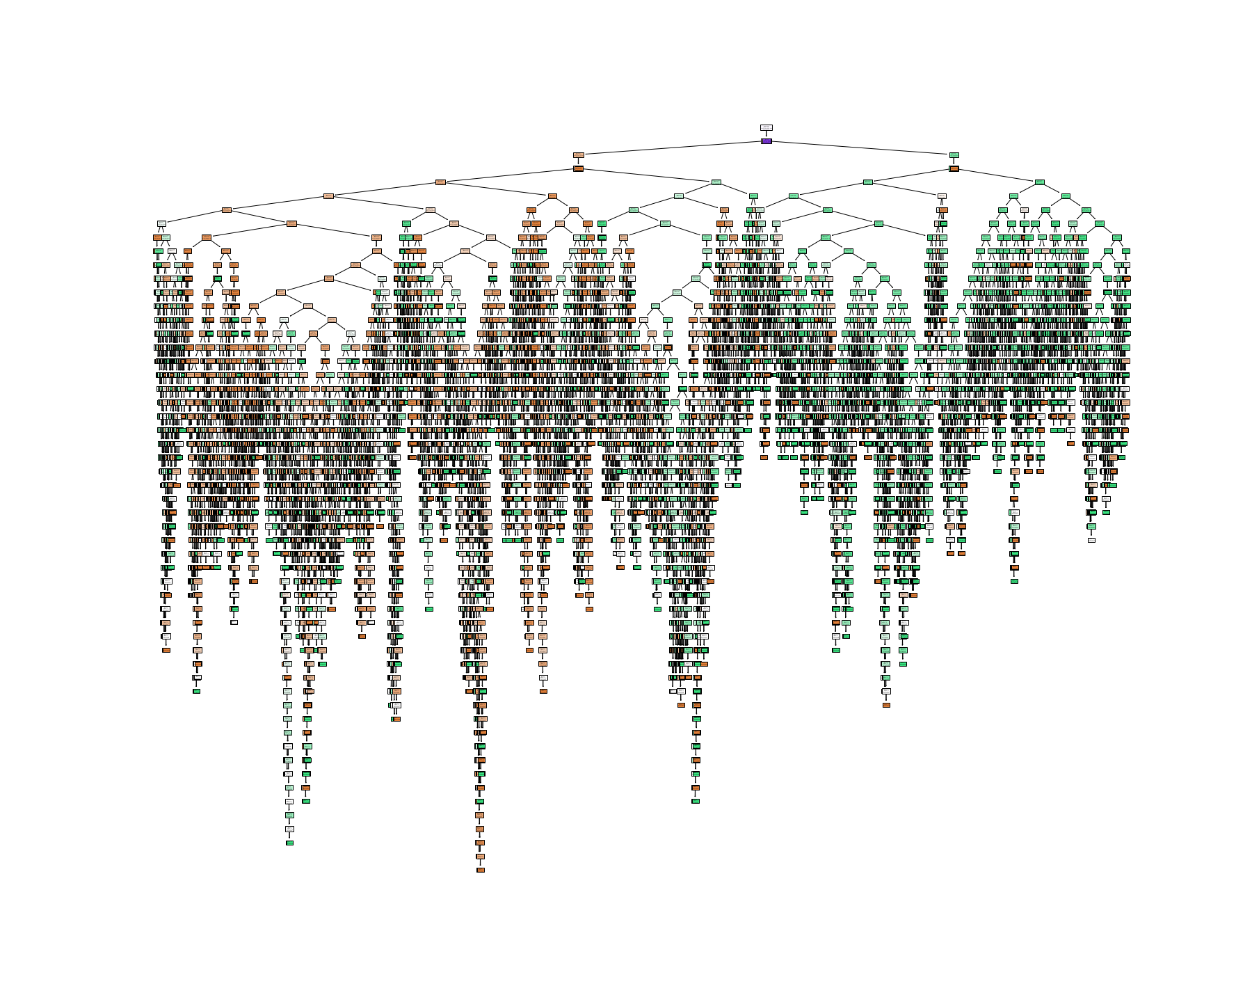
The Whole HHA Tree

Slide 7
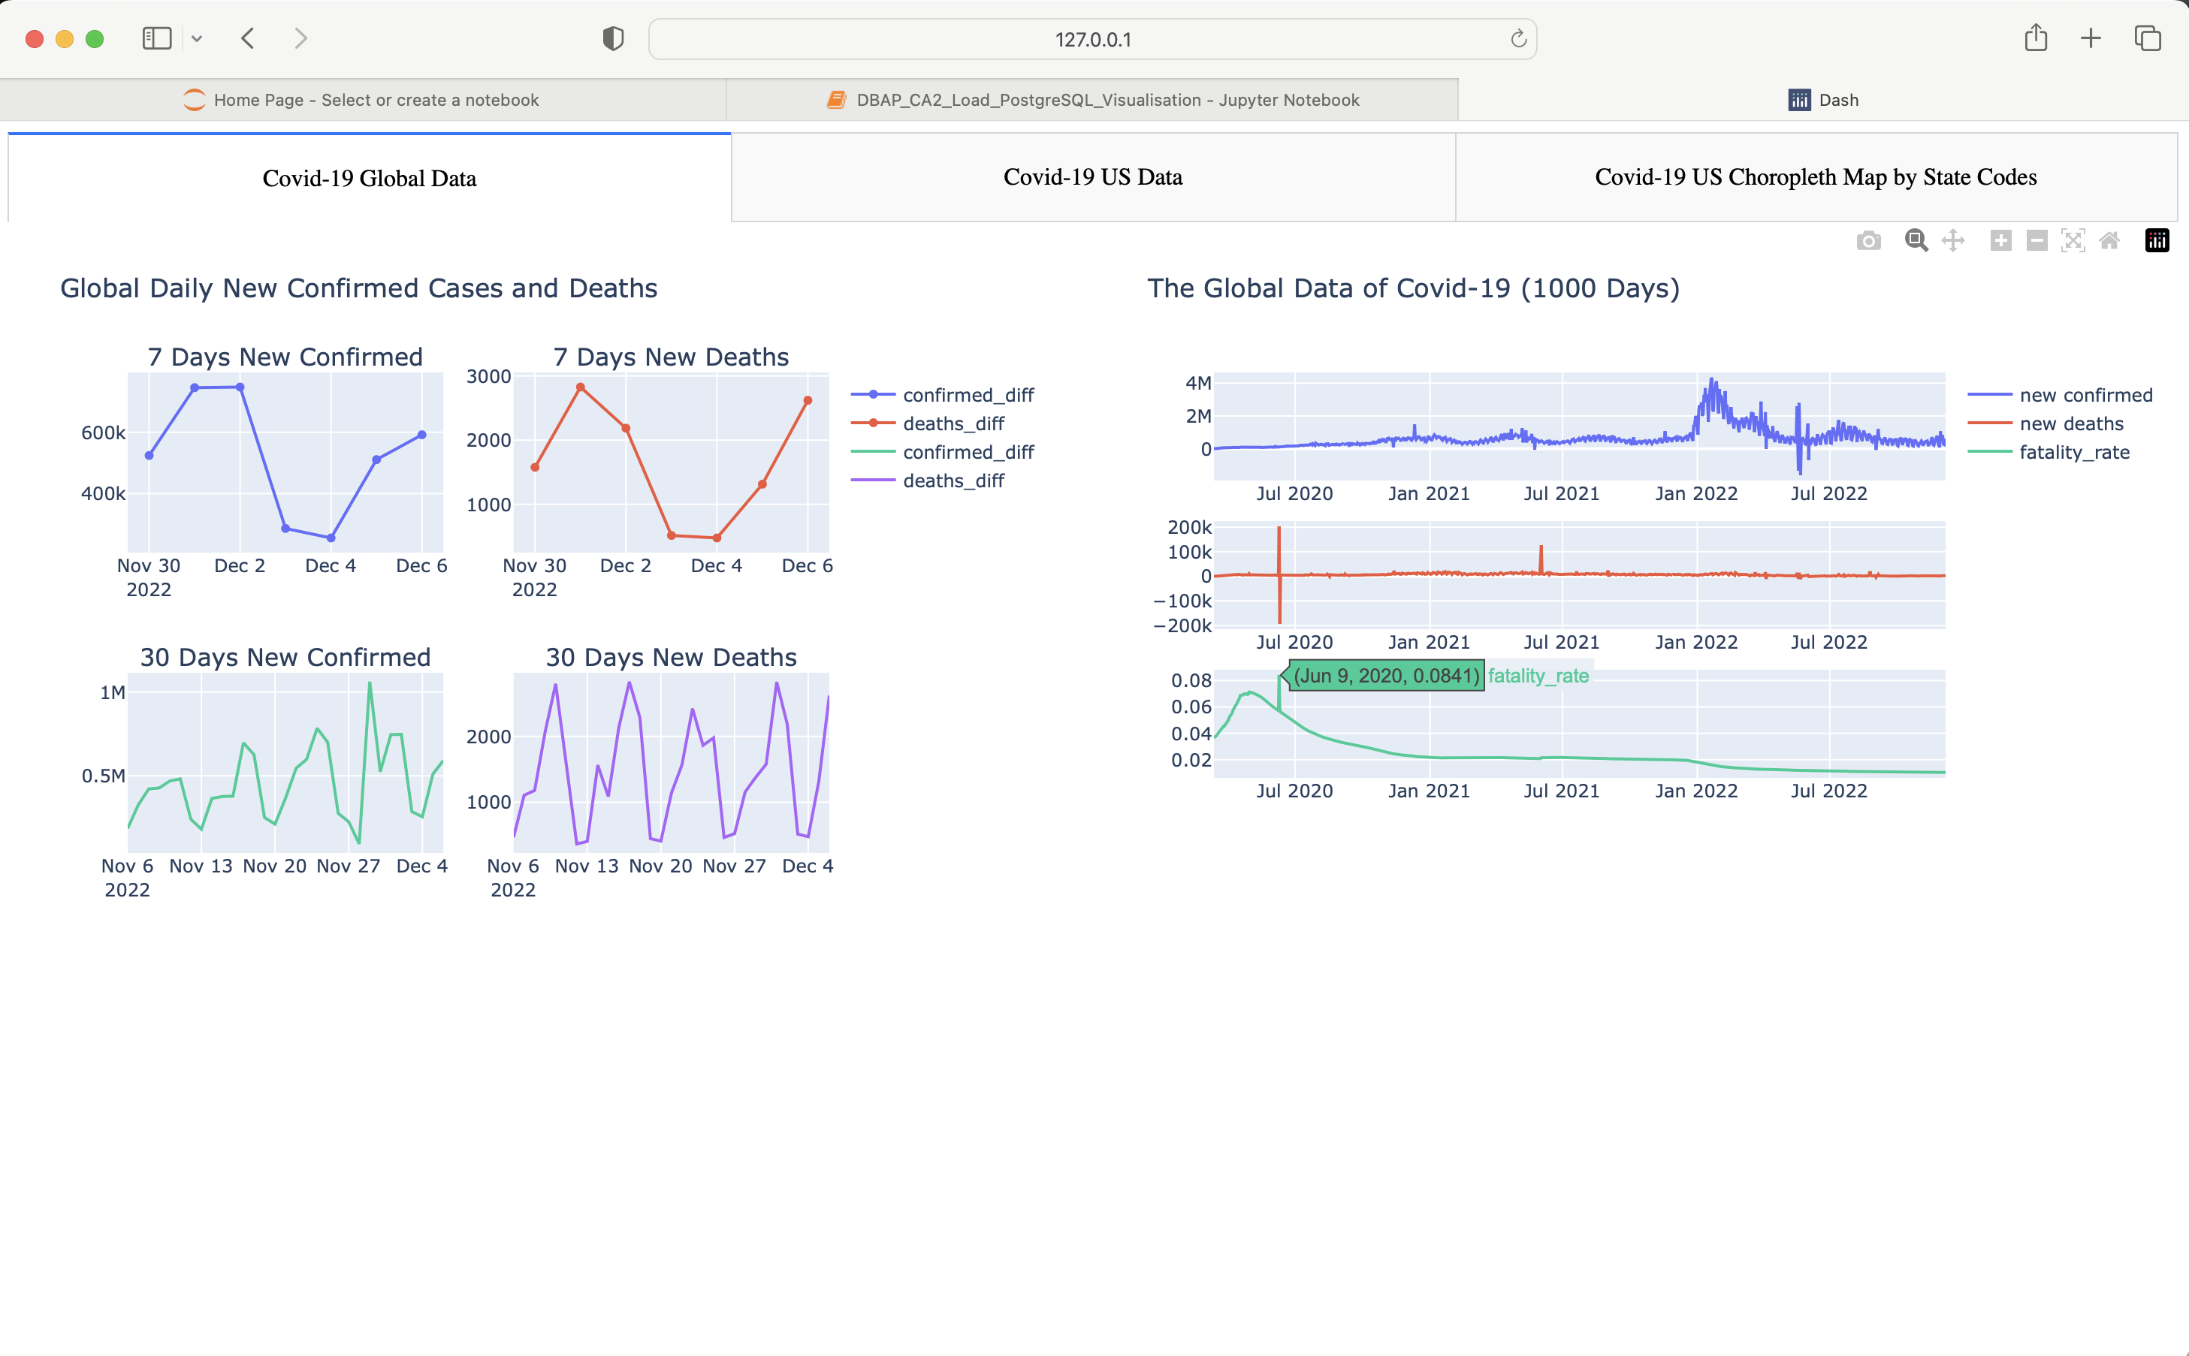


Slide 8
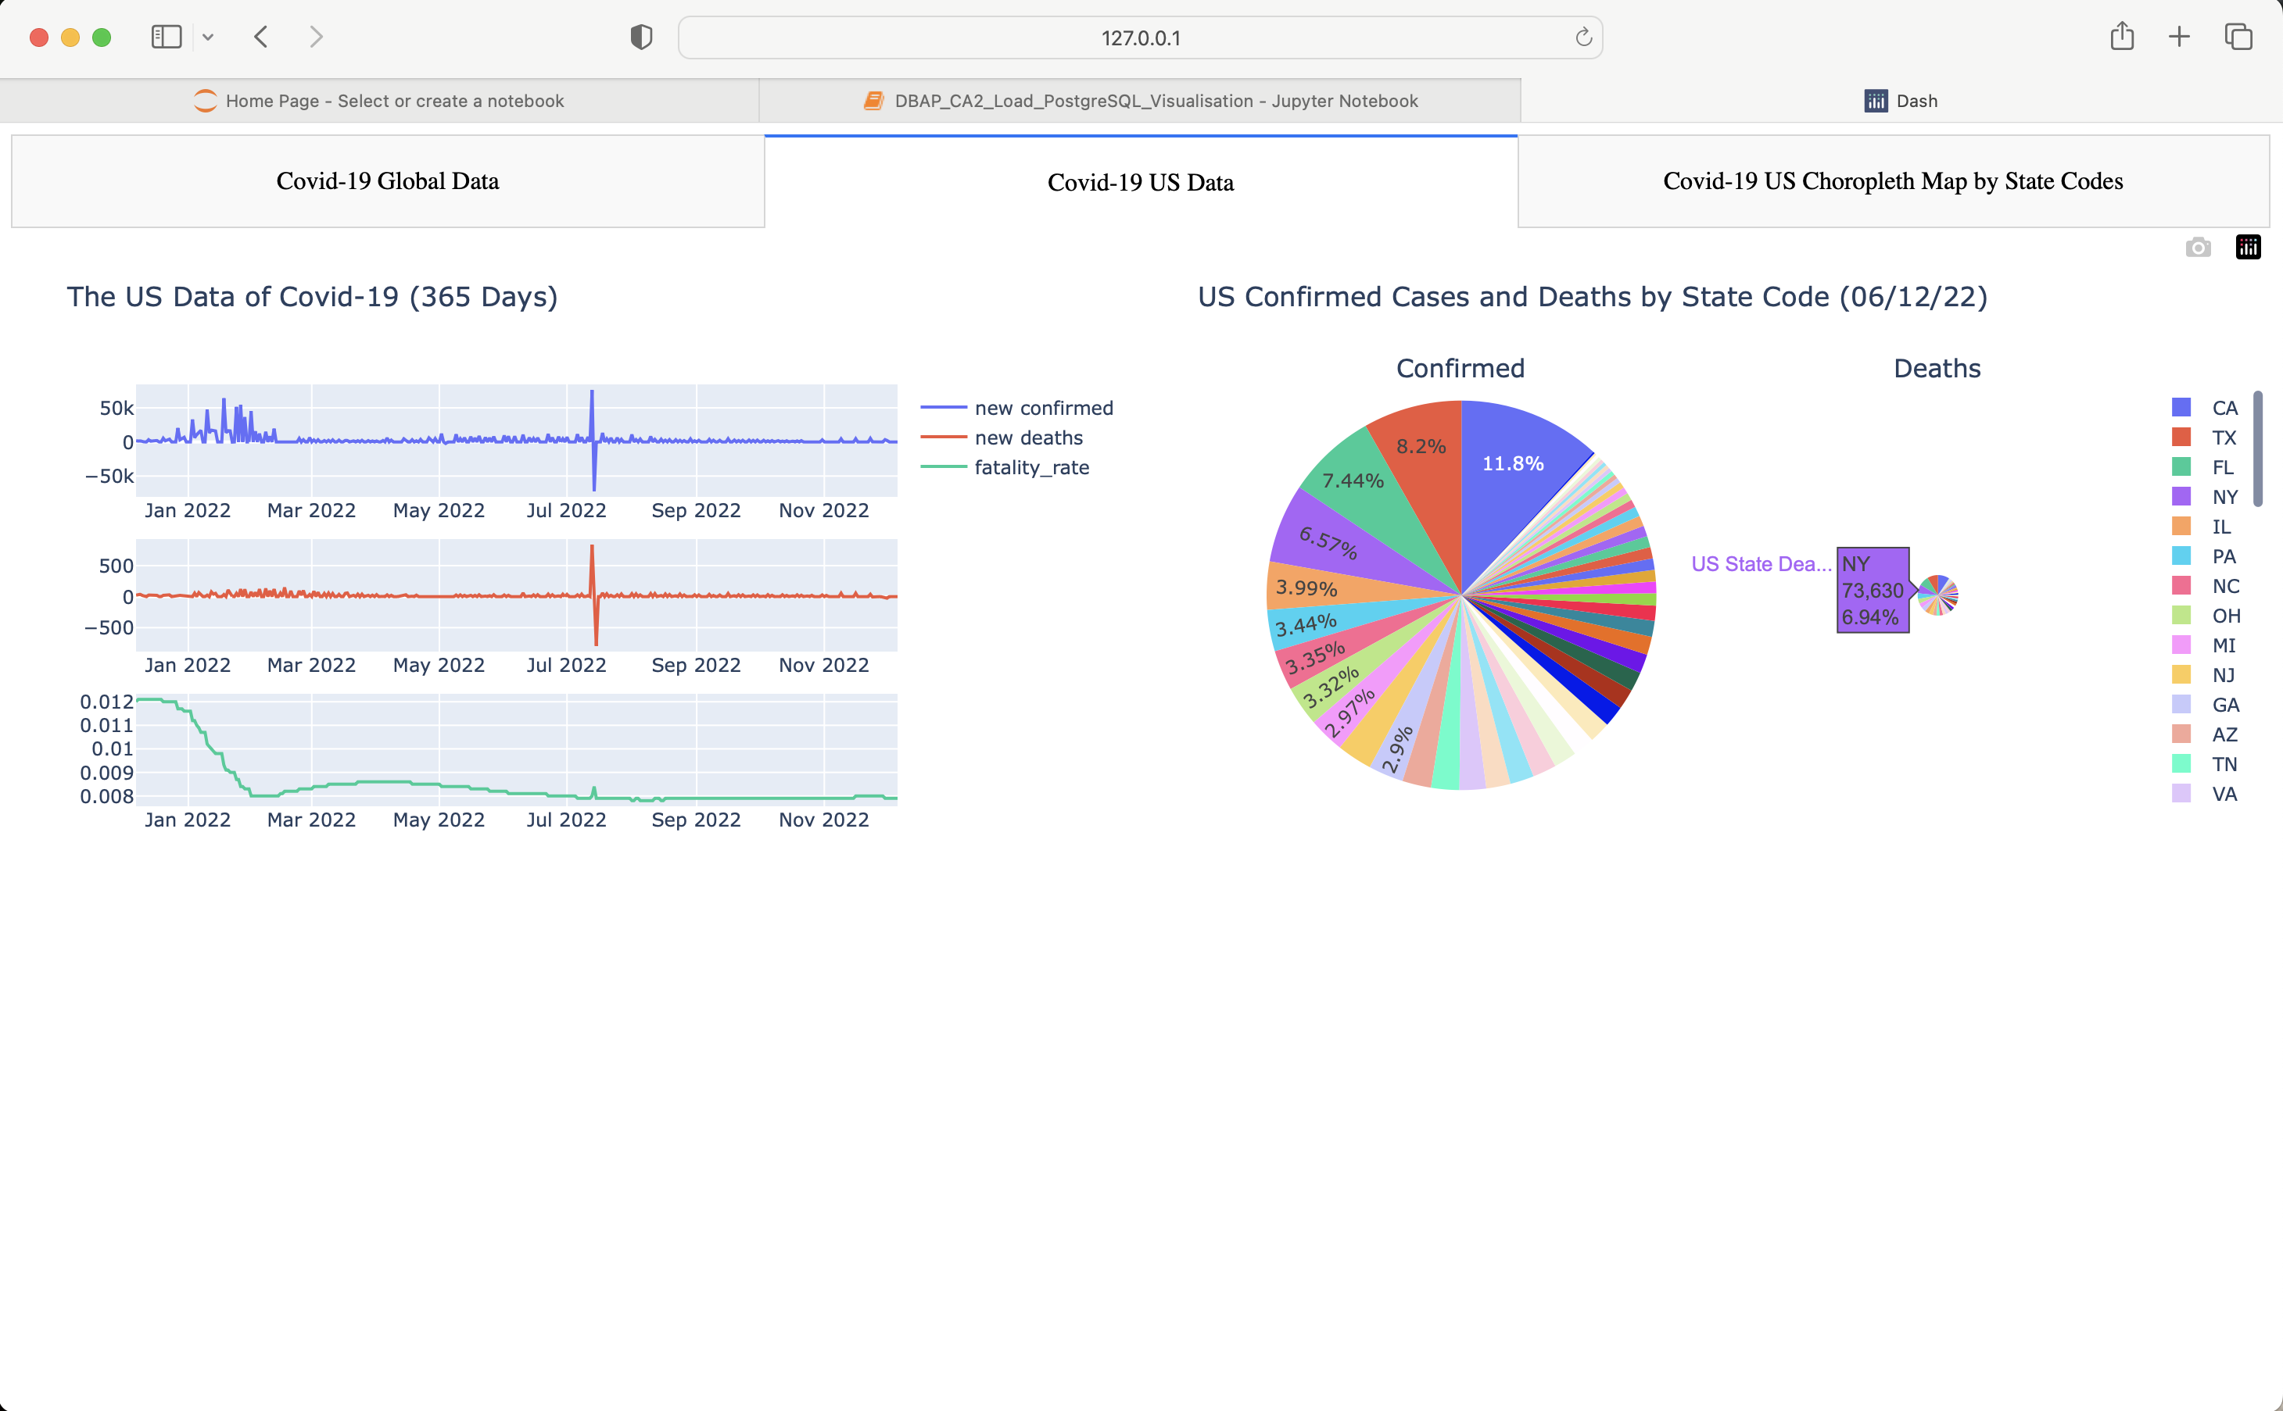

Slide 9
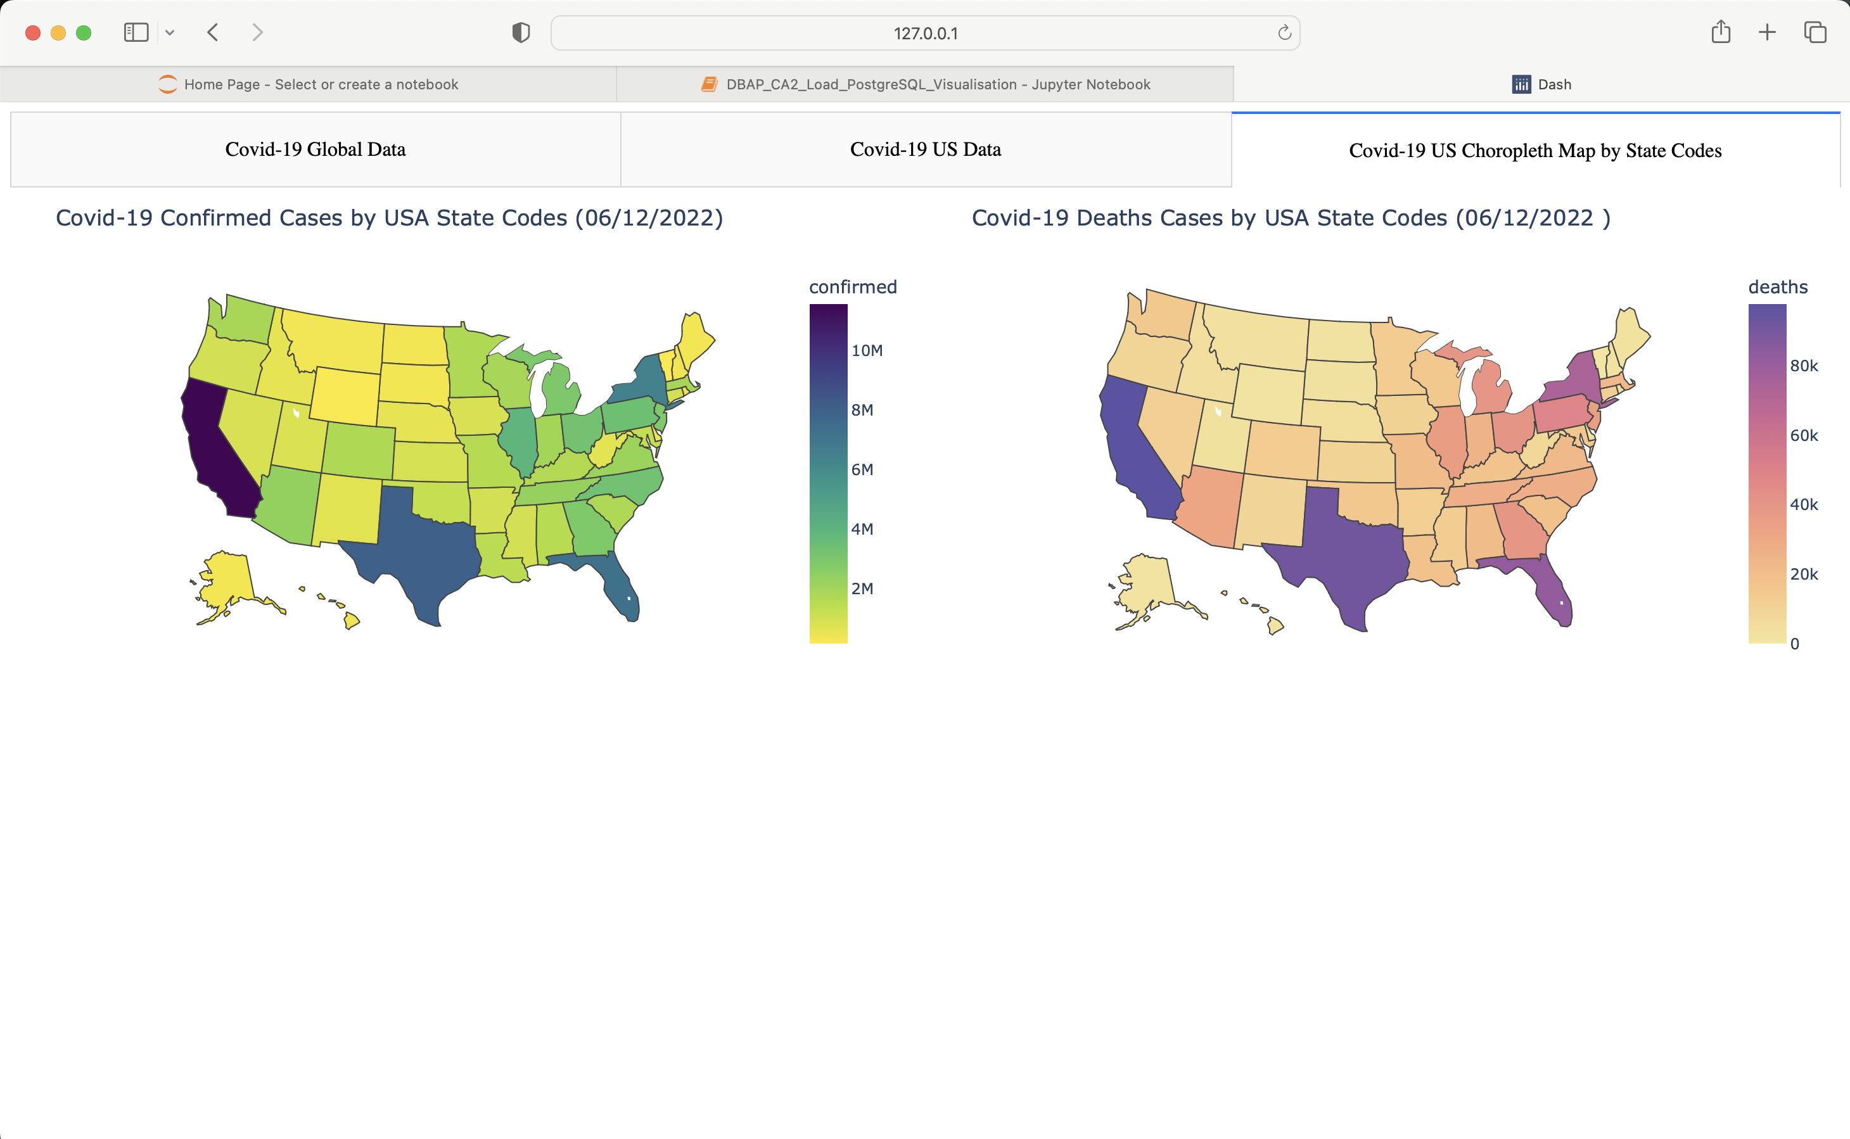

Slide 10
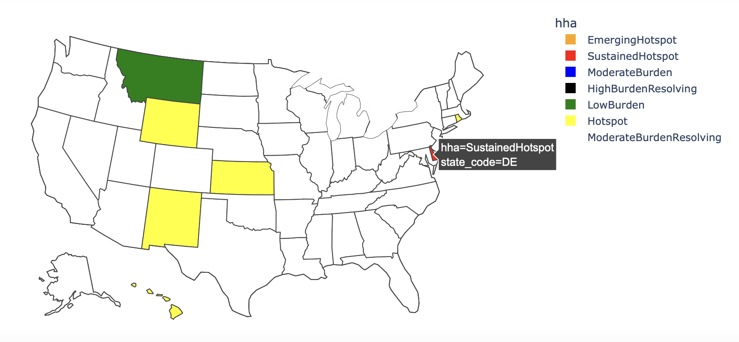

Slide 11
Conclusion and Future Work
Decision tree Machine Learning analysis helped us discovered that the status of hardest hit area by the pandemic is highly associated with low-income, rural area, and tribal community, as well as poverty percentage of those areas.
The authors would like to make further research on the hardest hit area and the impact factors using other Machine Learning Algorithms.
And the authors would like to develop a more detailed dashboard to present the pandemic situation and make our contributions to support vulnerable communities.

Slide 12
Thank You
Team C: Min Chen x19205040, Jia Lin x22117644

